Slide 2
Power BI with Analysis Services
Charlie Pyne
Cloud Solution Architect - Microsoft

Slide 3
Agenda
Prerequisites – Basic Power BI Knowledge
Overview of Analysis Services vs Power BI
When to use Analysis Services
How to setup Azure Analysis Services
Azure Analysis Services Gateway
How to deploy to deploy to Analysis Services
Demo
Questions???

Slide 4
Analysis services Enterprise grade analytics engine
Data sources
10 01
10 01
Transform complex data into business friendly models
Combine data from multiple data sources and apply business rules and security
Match performance to the speed of business
Explore models and gain instant insights using your favorite visualization tool
SQL
Oracle
IBM
Teradata
Sybase
Azure Blob
Data feeds
Excel
Files
Others
SQL Server Analysis Services
BI semantic model
Data modeling
In-memory cache
Security
Business logic & metrics
Lifecycle management
Visualize
Excel
Power BI
Third-party tools
Notes:
Key points:
SQL Server Analysis Services helps organizations transform complex data into business user friendly semantic models that can be consumed using their preferred data visualization tools.
Ref Links for data sources
https://docs.microsoft.com/en-us/sql/analysis-services/tabular-models/data-sources-supported-ssas-tabular
https://docs.microsoft.com/en-us/sql/analysis-services/multidimensional-models/supported-data-sources-ssas-multidimensional

Slide 5
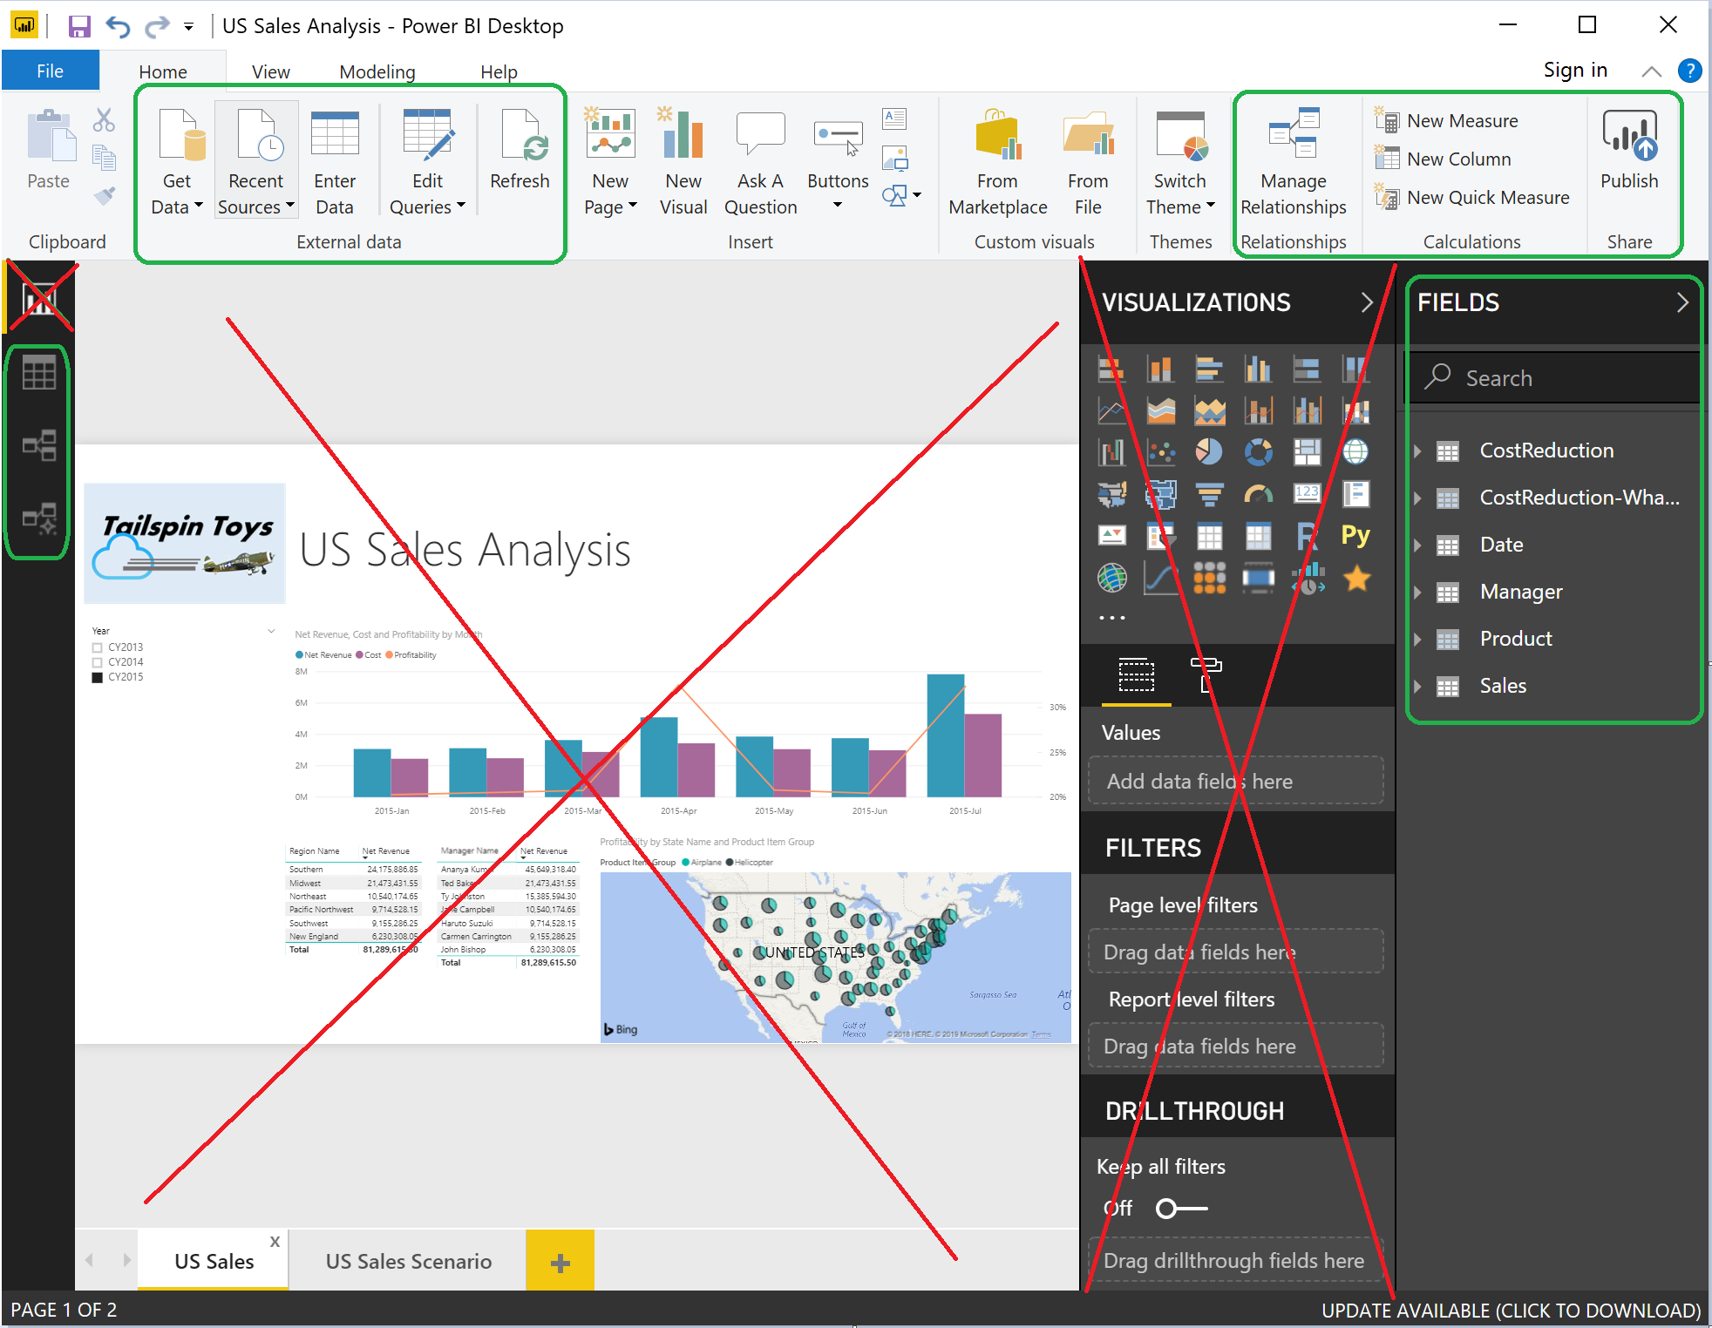
How does this relate to Power BI?
PowerBI tabular engine
Power Query
Calculated Columns
Calculated Measures
DAX

Slide 6
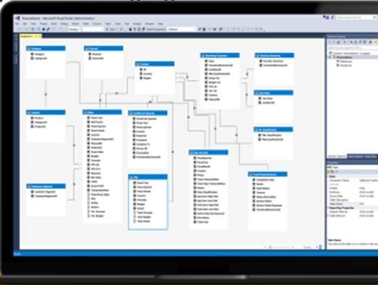
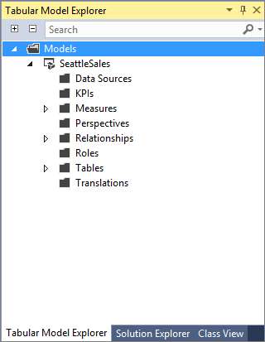
SQL Server Data Tools (SSDT)—2017
Used instead of Power BI Desktop for Data Modeling
Free
Available as a download
Modeling and analytics
Object level security
Developer tools
SSDT for VS 2017
DAX Editor for 2017 and SSMS
Notes:
Modeling and analytics Detail rows Enhanced support for ragged hierarchies Object level security
Developer tools SSDT for VS 2017 DAX Editor for 2017 and SSMS

Slide 7

One semantic model—two ways to develop
Tabular models
Multidimensional models
Tables and relationships
Fast by design with in-memory
Easy to get started and simple
Since SQL 2008 R2 - 2010
PowerBI & Power Pivot
Dimensions and measure groups
Highly scalable and mature
Feature rich and complex
Since SQL 7.0 - 1998
Notes:
Key Points (depending on the audience you might only show this slide or prior slide)
Overview of the semantic model options in SQL Server Analysis Services.
Tack track:
A BI semantic model allows you to easily abstract business problems and turn complex data into models that can be easily understood and can be used for reporting, analytics and dashboards.
SQL Server Analysis Services allows you to create one BI semantic model to be used with different client tools.
There are 2 ways to build it:
Tabular – consists of tables and relationships. Are fast by design with in-memory and are easy to get started.
Multidimensional – consists of dimensions and measure groups. Are highly scalable and mature, very feature rich but can add complexity.

Slide 8
Why use Analysis Services?
Power BI SKU | Max size of .pbix
Pro | < 1 GB
Premium 1 | < 3 GB
Premium 2 | < 6 GB
Premium P3, P4, P5 | up to 10 GB
Current Power BI Size Limits*
PowerBI Pro
1GB per pbix file
https://docs.microsoft.com/en-us/power-bi/service-admin-manage-your-data-storage-in-power-bi
PowerBI Premium
https://docs.microsoft.com/en-us/power-bi/service-premium-large-datasets
*As of Jan 2019

Slide 9
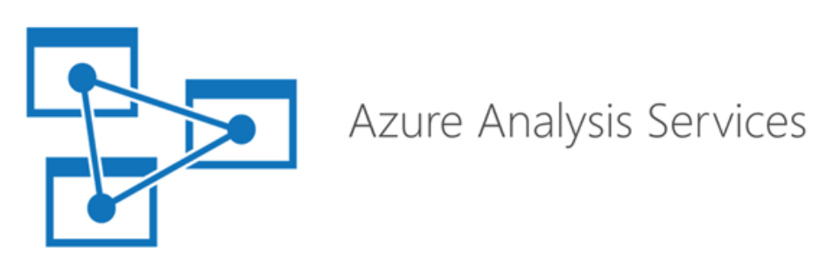

SQL Server vs Azure Analysis Services
Azure Analysis Services
PaaS Hosted and Managed
Up to 400GB Sizes
No maintenance required
SQL Server Analysis Services
On-Prem VMs or servers
Cloud IaaS VMs
Customer controls and manages VM

Slide 10

Demo 1: Tabular Model Development in SSDT
Create a data project
“Get Data”
Transform Data
Create Calculated Columns and Measures

Slide 11

Azure Analysis Services Architecture
Cloud visualization tools
Cloud data sources
Azure Analysis Services
SQL Database
Other data sources
Power BI
DirectQuery
SQL Data Warehouse
Cached Model
Power BI Embedded (GA)
Gateway
Authoring and development tools
On-premises data sources
On-premises visualization tools
SQL Server
Other data sources
Visual Studio
Excel
DirectQuery
Cached Model
Power BI Desktop
Third party BI tools
Oracle, Teradata
Note: not all capabilities available at public preview
Notes:
Azure AS other features
Scale up/down
Pause/resume
99.9% uptime SLA (GA)
New automation opportunities

Slide 12
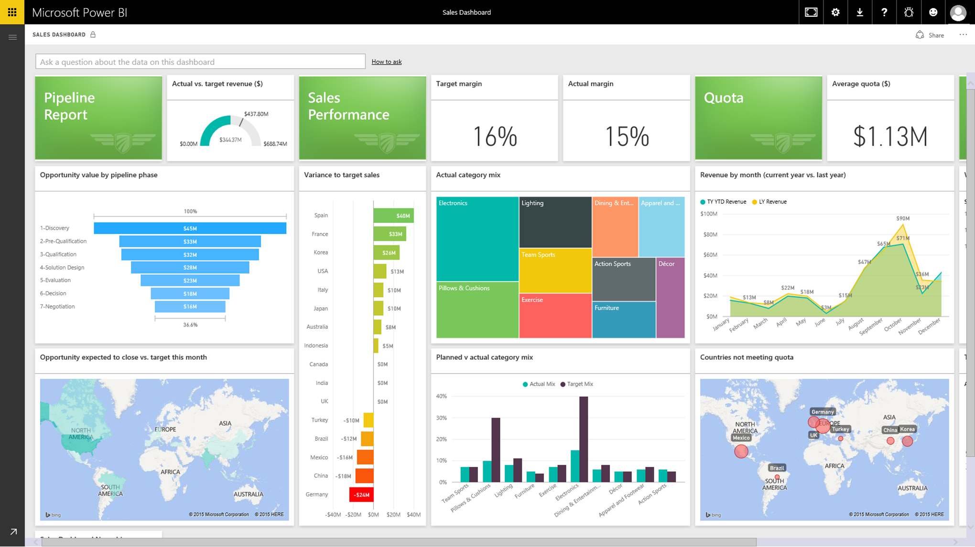
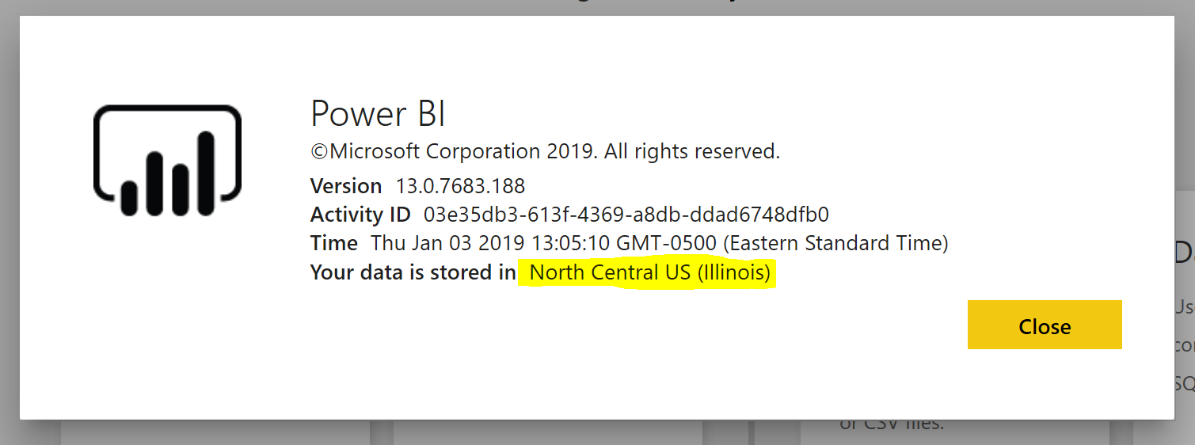
Azure Analysis Services Gateway
Use to refresh AAS from On-Prem data sources
Same software as Power BI Gateway
Can be used with both Power BI and AAS simultaneously
Generally a best practice to install in the same datacenter as your Power BI tenant
Live Power BI reports & dashboards
Analysis Services
Cloud
Live connection or
scheduled refresh
On-premises
Data Source
Data Source

Slide 13
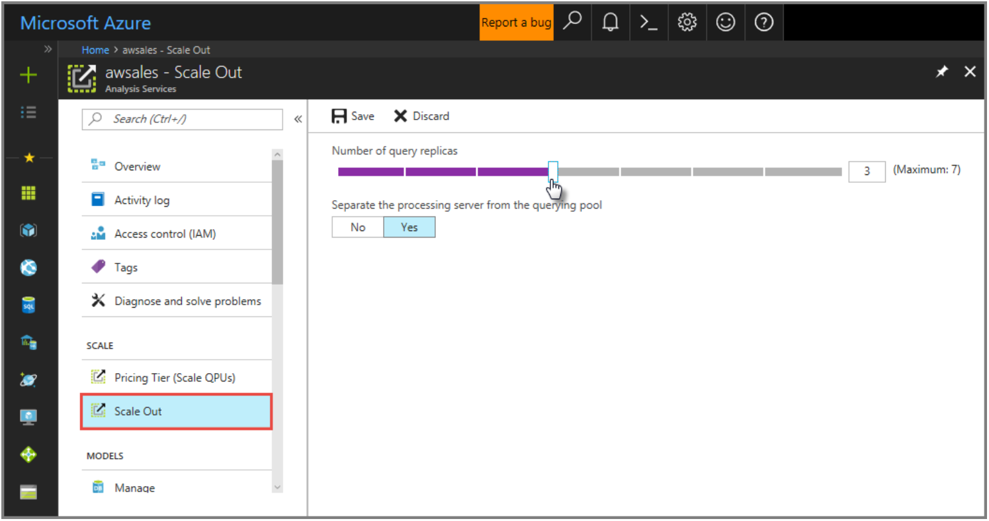
Scale Up / Down / Out
Quickly change AAS size to meet dynamic query and data requirements
Scale Out to multiple AAS instances
Pause AAS instances to temporarily suspend use and charges

Slide 14
Demo 2: Setup Azure Analysis Services
Deploy an AAS server
Install and configure the data gateway
Connect on-prem data to AAS
Deploy to Azure Analysis Services
Connect with PowerBI

